Slide 1
INFECTIOUS
DIARRHOEA
A Seminar Presentation
FACILITATOR: DR. E.KOMBA, HoD INTERNAL MEDICINE DEPARTMENT, MUHAS
PRESENTERS: DR. DOREEN WATUGULU AND DR. YASINI, MUHUDI

Slide 2
Learning Objectives
By the end of the session, the resident should be able to:
Classify and explain the epidemiology, causes, and pathophysiology of infectious diarrhea in adults.
Evaluate patients clinically by eliciting key history, performing focused examination,
Formulate differential diagnoses and select appropriate investigations
Develop evidence-based management plans
Recognize and implement prevention strategies, including infection control, public health measures, and patient education.

Slide 3
OUTLINE
Introduction
Epidemiology and Classification
Etiology and Pathophysiology
Clinical assessment
General Management
CDI
Infectious diarrhoea in immunocompromised
Vaccine in infectious diarrhea
References

Slide 4
INTRODUCTION
Diarrhea is defined as the passage of three or more loose or liquid stools per day, more frequently than is normal for the individual.
Diarrhoea is usually a symptom of an infection in the intestinal tract, which can be caused by a variety of bacterial, viral and parasitic organisms
World Health Organization [WHO]. Diarrhoeal disease: Fact sheet., 2024 (https://www.who.int/news-room/fact-sheets/detail/diarrhoeal-disease, accessed 18 March 2024)

Slide 5
INTRODUCTION
Gastroenteritis is inflammation of the stomach and intestinal epithelium.
Food poisoning is vomiting and/or diarrhoea caused by eating food contaminated with microorganisms or toxins (bacterial or otherwise, e.g. poisonous mushrooms).
Dysentery is bloody diarrhoea with mucus, tenesmus, pain, and fever usually caused by bacterial, parasitic, or protozoan infection
Notes:
Tenesmus is a painful , persistent painful urge to defecate or urinate , even when the bladders are empty
Gastroenteritis, commonly caused by viral pathogens (e.g., rotavirus, norovirus), bacterial pathogens (Salmonella, Shigella, Escherichia coli), or parasites (Giardia lamblia, Entamoeba histolytica), results in inflammation of the gastrointestinal tract lining. Symptoms vary based on the causative agent but typically include watery or bloody diarrhea, abdominal pain, nausea, vomiting, and systemic features like fever. Severe cases may lead to dehydration, especially in vulnerable populations such as children, the elderly, or immunocompromised individuals.

Slide 6
Conditions Mimicking Diarrhea
Pseudodiarrhea:
Frequent passage of small stool volumes, often with rectal urgency, tenesmus, or incomplete evacuation (seen in IBS or proctitis).
Fecal incontinence:
Involuntary rectal discharge due to neuromuscular or anorectal disorders. Severe diarrhea can worsen incontinence.
Overflow diarrhea: Occurs in patients with fecal impaction (e.g., nursing home patients).
Notes:
Proctitis is the inflammation of the lining of the rectum , the final section of the large intestine.

Slide 7
EPIDEMIOLOGY
Diarrhea is a major global health issue, particularly in low-income countries where sanitation and healthcare access are limited.
Its burden varies based on factors such as age, geography, and socioeconomic status.
1.7 Billions episodes of diarrheal illness annually (WHO,2023)
1.3 million deaths per year; 2nd leading cause of death in children <5 globally (WHO, 2023)
88% is attributable to unsafe water, sanitation & hygiene (WASH) deficits (WHO, 2019)
.
Notes:
This data is taken from WHO fact sheets regarding childhood diarrhoea diseases global incidence

Slide 8
Epidemiology cont…
Developing Countries: Higher prevalence due to poor sanitation, contaminated water, and malnutrition.
Developed Countries: Often caused by viral infections, foodborne illness, or antibiotic-associated diarrhea
Global estimates for the prevalence of specific types of bacterial diarrhea among all diarrheal causes include E.coli 10% to 25%, Shigella 10%, Salmonella 3%, Campylobacter 3% to 6%
Notes:
Title; specific incidence and mortality of diarrheal diseases in the African region: a systematic review and meta-analysis
Estimated 1005 billion diarrhea cases,
methods; Through a systematic review and meta-analysis of data from African LMICs, we estimated the etiology proportions for diarrheal diseases and deaths. We combined the etiology proportions with incidence data collected from a population survey in Africa from 2020 and mortality data from the Global Health Observatory of WHO.
E.Coli and giadia lambia were the leading causes in children under 5
Above five mostly salmonella
These findings provide new information on the incidence and mortality of sixteen pathogens and highlight the need for surveillance and control of diarrheal infectious diseases in Africa. The cause-specific estimates are crucial for prioritizing diarrheal disease prevention in the region.

Slide 9
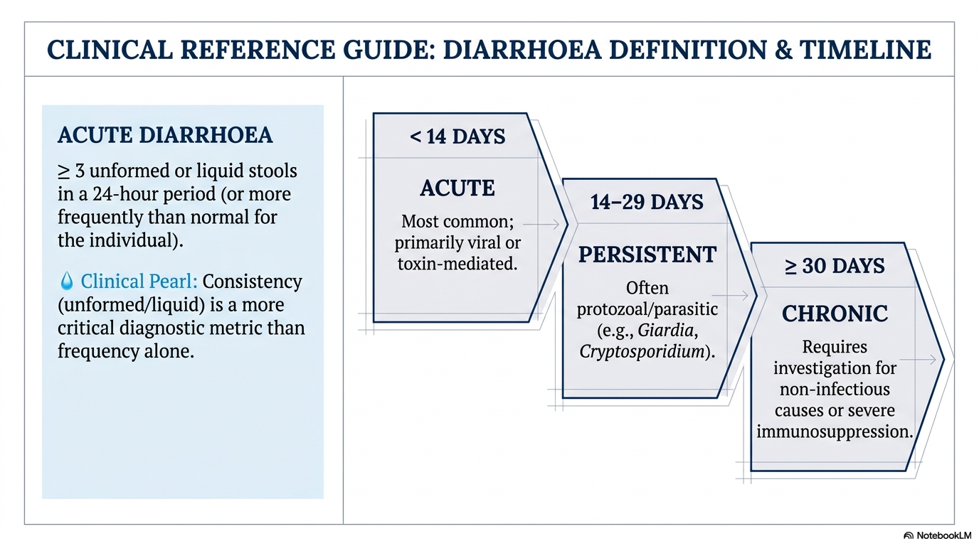
Notes:
Chronic Diarrhea is defined as the passing of sloppy or mushy stools with increased frequency, the urgency of bowel movements, or incontinence. Typically leads nutritional and metabolic consequences, such as stunted growth.
Reference from infectious diseases society of America
American academy of family physicians 2022
Stat pearls 2024

Slide 10
Mechanisms of infectious diarrhea
Secretory
Osmotic
Inflammatory
Cytotoxic
Dysmotility or functional/altered motility

Slide 11
Secretory diarrhoea (toxin-mediated)
This occurs when pathogens produce enterotoxins that stimulate intestinal secretion without damaging mucosa.
Activation of adenylate cyclase or guanylate cyclase
↑ cAMP or cGMP
↑ chloride secretion via CFTR channels
Water follows → profuse watery diarrhoea
Key features:
Large-volume watery stool
No blood or pus
Continues even during fasting
Example of microorganisms are Vibrio cholerae and Enterotoxigenic Escherichia coli (ETEC)
Notes:
The trigger instead of attacking your intestinal walls directly , it releases enterotoxins which are chemical messengers that confuse your cells and turn on enzymes called adenyl cyclase which increases the levels of molecules called cAMP., which unlocks chloride channels CFTR . Salt starts pouring out of your cells and into your intestines her.
There is no blood or pus because actually the bacteria are not damaging the tissue.
CFTR-cystic fibrosis transmembrane conductance regulator.

Slide 12
Osmotic diarrhoea
Occurs when unabsorbed solutes retain water in the lumen.
Infection damages absorptive cells (enterocytes)
↓ disaccharidase activity (e.g., lactase)
Accumulation of osmotically active substances
Key features:
Improves with fasting
Bloating and gas common
Common cause is Viral infections (e.g., norovirus, rotavirus), Cryptosporidium, Giardia
Notes:
Rotavirus damaging the enterocytes (the cells that absorb nutrients)
Lacking lactase , if you drink milk and cant break down lactose (sugar)
The sponge effect ;
If you stop eating something that can’t absorb , diarrhea stops.
Because the unabsorbed food sits on your gut , your naturaak gut bacteria start to ferment , the fermentation produces the gas and painful bloating.

Slide 13
Inflammatory (exudative) diarrhoea
Due to invasion or cytotoxic damage to intestinal mucosa.
Pathogens invade epithelial cells
Trigger inflammatory response
Mucosal ulceration
Leakage of blood, mucus and proteins
Reduced absorption
Classicorganisms:Shigella,Salmonella,Campylobacter jejuni and Enteroinvasive E. coli (EIEC)
Key features: Fever, Abdominal pain, Bloody diarrhoea (dysentery) and tenesmus
Notes:
Bacteria like shigella or salmonella actually enter and live inside your intestinal cells. Release toxins that Causing ulcers
Lining of the intestines is damaged.
Cytotoxicity ; they release toxicins that kill the celss , causing ulcers in the lining of the gut
Because the wall is brocken, so it is not just leaking out anymore, it is blood, mucus and protein (exudate)
Fever- the immune sys is actively fighting an invasion , the body’s temperature.

Slide 14
Cytotoxic diarrhea
Caused by toxins that directly damage intestinal cells.
Toxin-induced apoptosis or necrosis of enterocytes
Loss of mucosal integrity
Inflammation + secretion
Key features:
Watery or bloody diarrhoea
Often post-antibiotic
Can lead to pseudomembranous colitis
ExampleClostridioides difficile (toxins A & B)
Notes:
Because the cells are dying your body sends in the immune system to fight back. This causes inflammation which makes the gut wall red , swollen and leaky
You get a mix of watery dirrhea and bloody stool.
Wipes away the friendly bacteria in the gut lining. Which releases toxin A and B which poison the gut lining. The dead cells , white blood cellss and protein create yellowish fake membrane over the surface of the colon. Which is called very high cytotoxic activity.

Slide 15
Motility-related diarrhoea
Some infections alter gut motility.
Mechanism:
Increased peristalsis
Reduced contact time for absorption
Seen in:
Post infective-IBS overlap
Early stages of some bacterial or viral infections
Notes:
Post IBS; very common when after a person recovers from a bad bour of food poisoning like salmonella or campylobacter, their gut nerves remain hypertensive. This leads to IBS where the gut overacts to food of speeding up

Slide 16
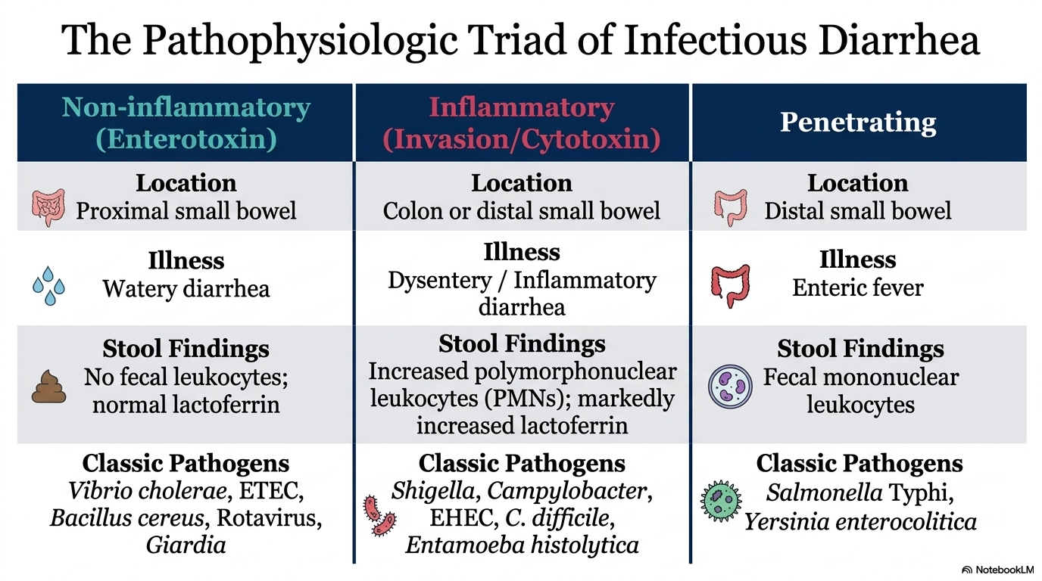
Harrisons_Principles_of_Internal_Medicine, 22nd_Edition
Notes:
1. Non-inflammatory (Watery)This is caused by toxins that hinders how the gut absorbs water, but they don't actually damage the tissue.
the secretory and osmotic types , the bacteria and viruses are just passing through or releasing toxins.
Lactoferrin-biomarker of intestinal inflammation, fecal lactoferrin is the glycoprotein released by activated neutrophils, if present in stool suggest neutrophilic inflammation in the gut
2. Inflammatory (Bloody/Dysentery)This happens when the germs physically invade the lining of the gut or release toxins that kill cells.
3. Penetrating (Systemic)The germs don't just stay in the gut; they "penetrate" through the lining to get into the rest of the body.
Inflamamtory-are attacking and destroying the gut lining
Penetratings- they burrow the intestines
ETEC-Enterotoxigenic escheria coli-travellers diarrhea

Slide 17
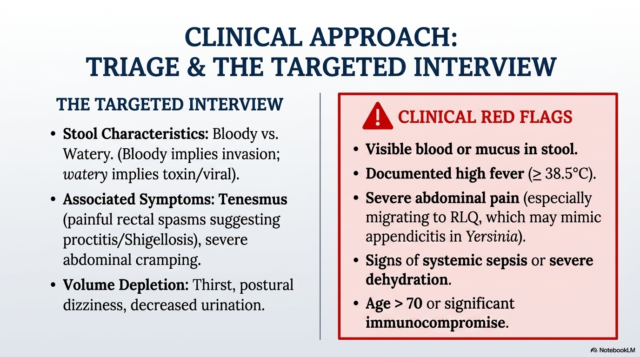
Notes:
Watery with no fever-rehydrate and monitor
Bloody plus fever plus RLQ-investigate invasive bacteria

Slide 18
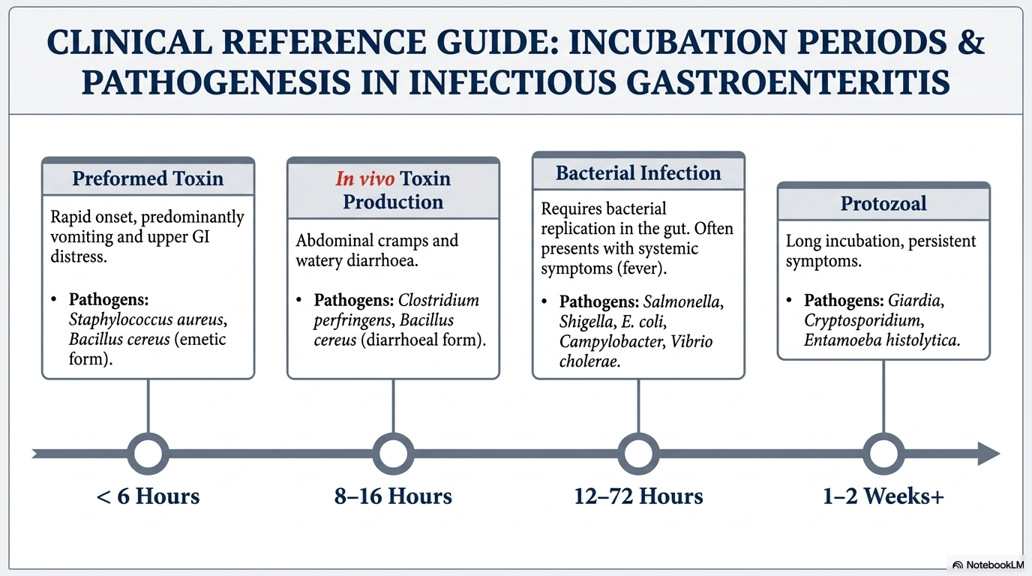
Notes:
Infectious diarrhea exhibits signs and symptoms such as
fever, bloody, mucous or watery stools, sepsis manifesta-
tions or dehydration , vomiting, abdominal discomfort,
Incubation period-time from initial exposure to a pathogen and the first appearance of signs and symptoms.
*T ime: Less than 6 hours.* What's happening: You didn't just eat bacteria; you ate the poison (toxin) the bacteria already left in the food. Because the poison is already there, your body reacts almost immediately.
Time: 8 to 16 hours.* What's happening: You ate the bacteria, and once they got inside your gut (in vivo), they started manufacturing the poison. This takes a few hours to "ramp up."* Main Symptoms: Abdominal cramps and watery diarrhea.* Examples: Clostridium perfringens.
3. Bacterial Infection (The "True" Infection)* Time: 12 to 72 hours (1–3 days).* What's happening: The bacteria need to settle in, multiply (replicate), and sometimes invade the lining of your gut. This process takes a day or two.* Main Symptoms: You start feeling "whole-body" sick, often with a fever.
4. Protozoal (The "Slow" Burner)* Time: 1 to 2 weeks or more.* What's happening: These are parasites (protozoa). They grow much slower than bacteria. You might forget what you even ate by the time you feel sick.* Main Symptoms: Symptoms that last a long time (persistent) and may come and go.* Examples: Giardia and Entamoeba histolytica (Amoebiasis).

Slide 19
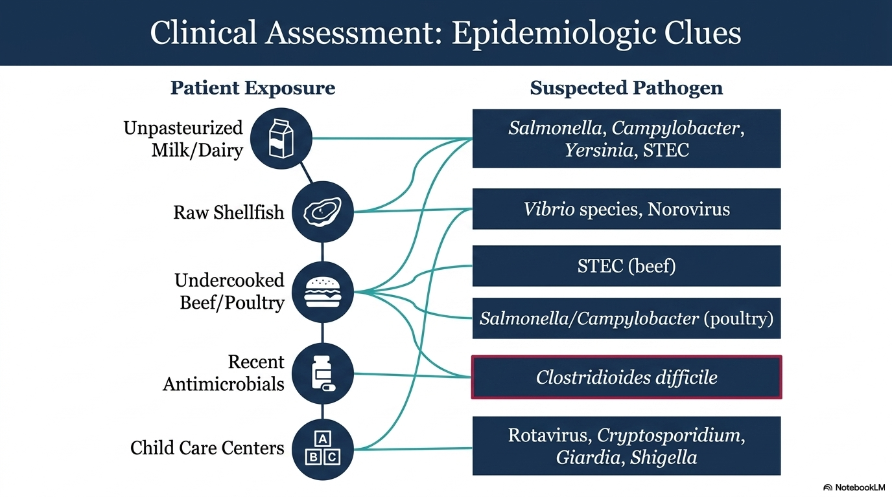
Notes:
From harrisons
STEC-Shiga toxin producing Escherichia coli

Slide 20
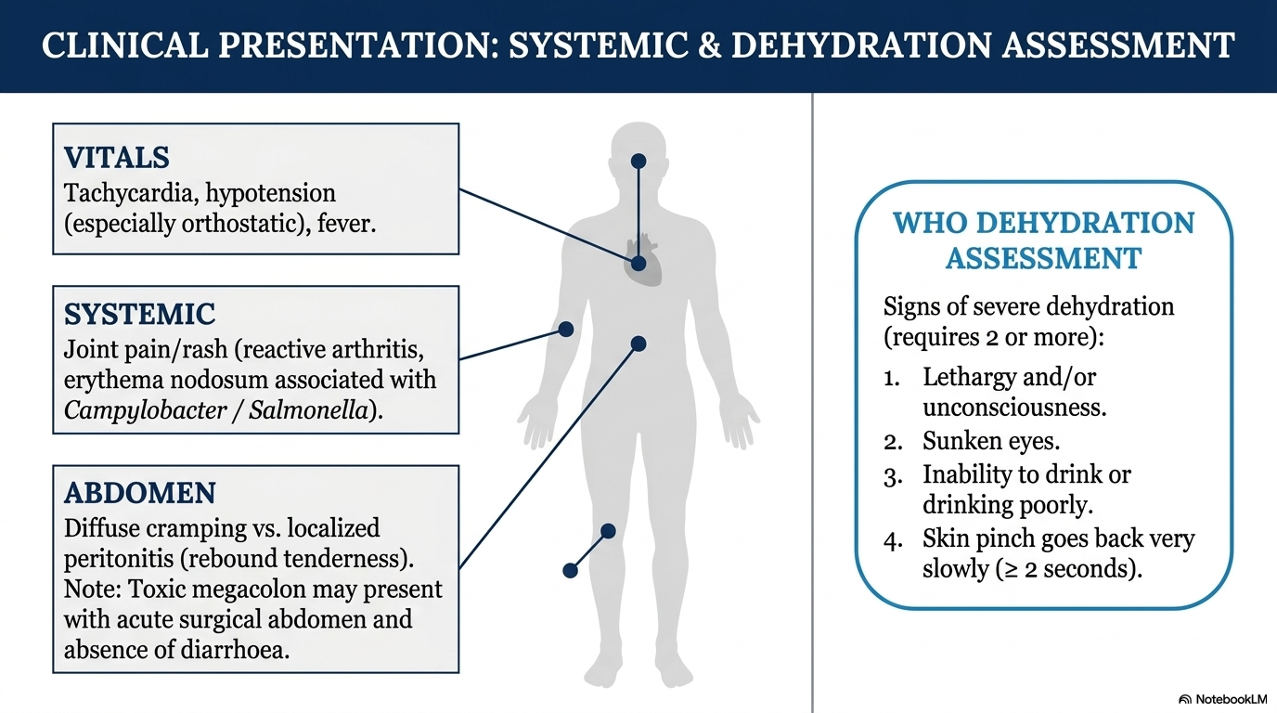
Notes:
Campylobacter infection- it’s the body/s immune system overreacting after the iniial gut infection has cleared.
Post infectious complication through a mechanism known as molecular mimicry
The immune system produces antibodies to fight campylobacter. Some of the proteins on the surface of the bacteria look very similar to proteins found in human joint tissue. Where the confused antibodies begin attacking the synovium joints leading to inflmammation , swelling and pain.
Erythema nodisum – delayed hypersensitivity occurring in the subcutaneous fat layer of the skin
Common is Guillain Barre syndrome where the immune system to attack the peripheral nerves , leading to ascending paralysis
Fever- immune syst produces cytokines , where these cytokines travel through the blood to brain hypothalamus , stimulating the prostaglandins which tell the hypothalamus to raise tempe
Tachy and hypo- low blood volume , diarrhea causes massive loss of water and electrolytes which reduces total circulating blood volume , tahycaridia is compensatory when the blood pressure is dropped via baroreceptors . It triggers the symphathetic nervous system to release adrenaline which tells the heart to beat faster to maintain cardiac output.
Toxic megacolon- dilated colon accompanied by signs of systemic toxicity , severe inflammation casues the smooth muscles to become paralyzed

Slide 21
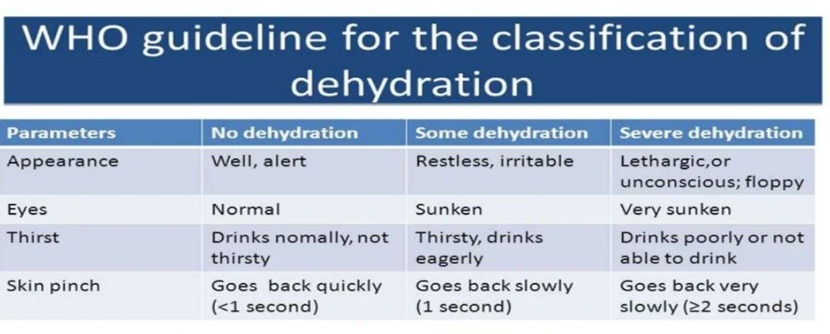
Notes:
World Health Organization (WHO) scale for dehydration
Also in WHO Module 4 on diarrhea published in 2014

Slide 22
CLINICAL ASSESSMENT CONT…
Severity of diarrhea may be assessed by Bristol stool form scale
Provides verbal and visual reference scale
Scaled from 1 to 7
Recorded on a chart or patient’s database
Notes:
Developed in 1990 it was first used to monitor patients with IBS

Slide 23
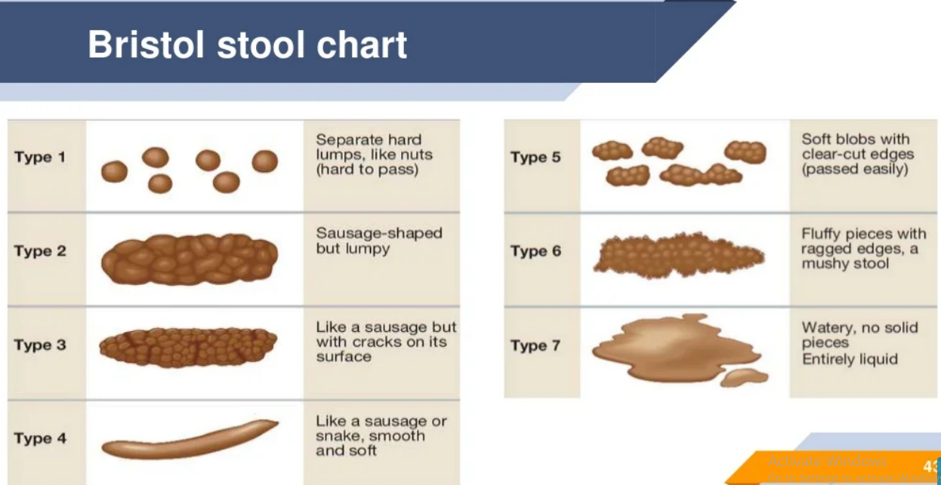
Notes:
RAO ss
Tells how a person is improving and how , if you treating for campylobacter starts tx and stool moves from type 7 to type 5-they are improving.
If remains at type 6 for over 2 weeks you should look for protozoal column of your guide
Or how

Slide 24
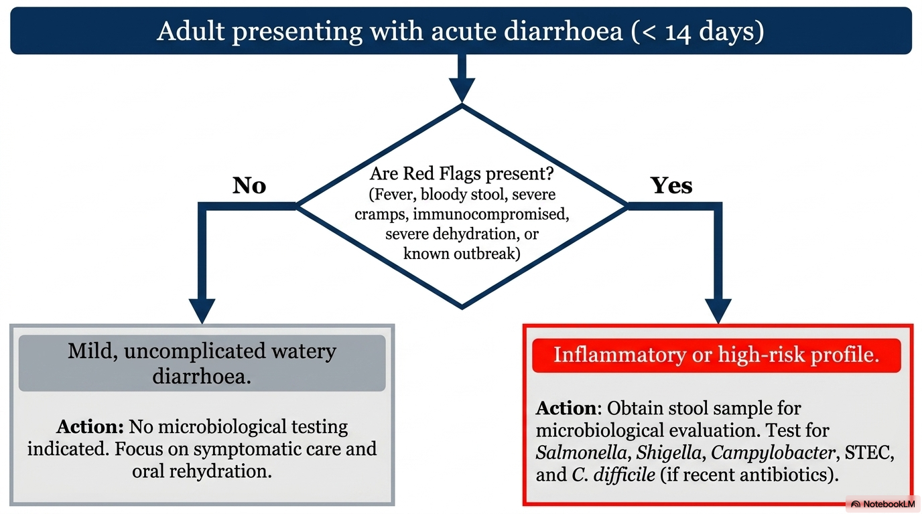
2024 Updates by the Infectious Disease Society of America and American Society of Microbiology. Guide to Utilization of the Microbiology Laboratory for Diagnosis of Infectious Diseases
Notes:
Guide to Utilization of the Microbiology Laboratory for Diagnosis of Infectious Diseases: 2024 Update by the Infectious Diseases Society of America (IDSA) and the American Society for Microbiology (ASM)\
Study done my michale miller et al,
This document, developed by experts in both adult and pediatric laboratory and clinical medicine, provides information on which tests are valuable and in which contexts, and on tests that add little or no value for diagnostic decisions.

Slide 25
INVESTIGATION
The specimen of choice to diagnose diarrheal illness is Diarrheal stool, not formed stool or swab except for pediatric
Stool inspection for blood and microscopy for leucocytes, ova, cysts, parasites

Slide 26
INVESTIGATIONS
Stool culture, C. difficile toxin should be sought
FBP and electrolytes
Examination of wet film with dark-field microscopy for darting motility in cholera endemic areas
In malarious areas, malaria testing protocol should be followed
2024 Updates by the Infectious Disease Society of America and American Society of Microbiology. Guide to Utilization of the Microbiology Laboratory for Diagnosis of Infectious Diseases
Notes:
Wetfilm- bedside diagnostic technique used to identify vibrio cholerae based on its movement

Slide 27
INVESTIGATIONS
Culture independent multiplex molecular tests are reported to be more sensitive than culture, though it is more costful than culture.
Toxin or NAAT for C. difficile should only be done on diarrheal stool.
Randel, A et al, Infectious Diarrhea: IDSA Updates Guidelines for Diagnosis and Management, 2018
Notes:
NAAT-Nucleic acid amplification tests –detects DNA or RNA of a pathogen
Pcr, RT-PCR LCR, LAMP
emphasize using culture-independent, molecular tests (like PCR panels) for diagnosing acute, persistent, or traveler's diarrhea in high-risk groups, including children, the elderly, and immunocompromised patients

Slide 28
INVESTIGATIONS CONT…
Blood and urine cultures, and chest X Ray may identify alternative sites of infection particularly if the clinical picture suggests a syndrome other than gastroenteritis
Uncharacterized persistent diarrhea: Sigmoidoscopy, colonoscopy, abdominal CT scan
Shane, A. L., Mody, R. K., Crump, J. A., Tarr, P. I., Steiner, T. S., Kotloff, K., et at. 2017 Infectious Diseases Society of America Clinical Practice Guidelines for the Diagnosis and Management of Infectious Diarrhea. Clinical Infectious Diseases, 65(12), e45–e80.
Notes:
Also can identify ischemic colitis, diverticulitis, IBD, partial bowel obstruction
Used to examine the disatl portion of the colon rectum and sigmoid colon

Slide 29
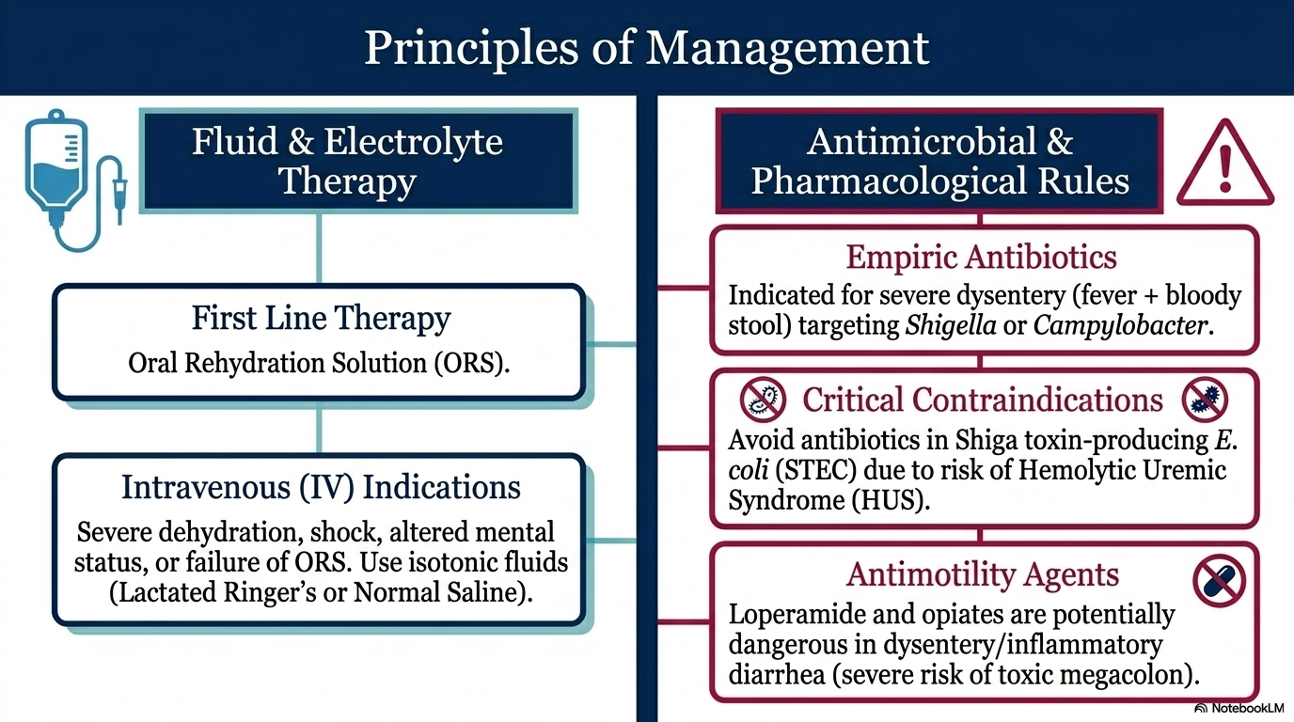
The WHO AWaRe (Access, Watch, Reserve) Antibiotic Book, 2022)
Notes:
STEC clinical clues Bloody diarrhea initially start as watery diarrhea with little or no fever, compared to shigellosis and campylobacter which always has high fever

Slide 30
Indication of empirical antibiotic use
Generally recommended in:
  Traveler’s diarrhea
  Elderly and immune-compromised
  Patients with prosthetic valves or synthetic vascular grafts

Slide 31
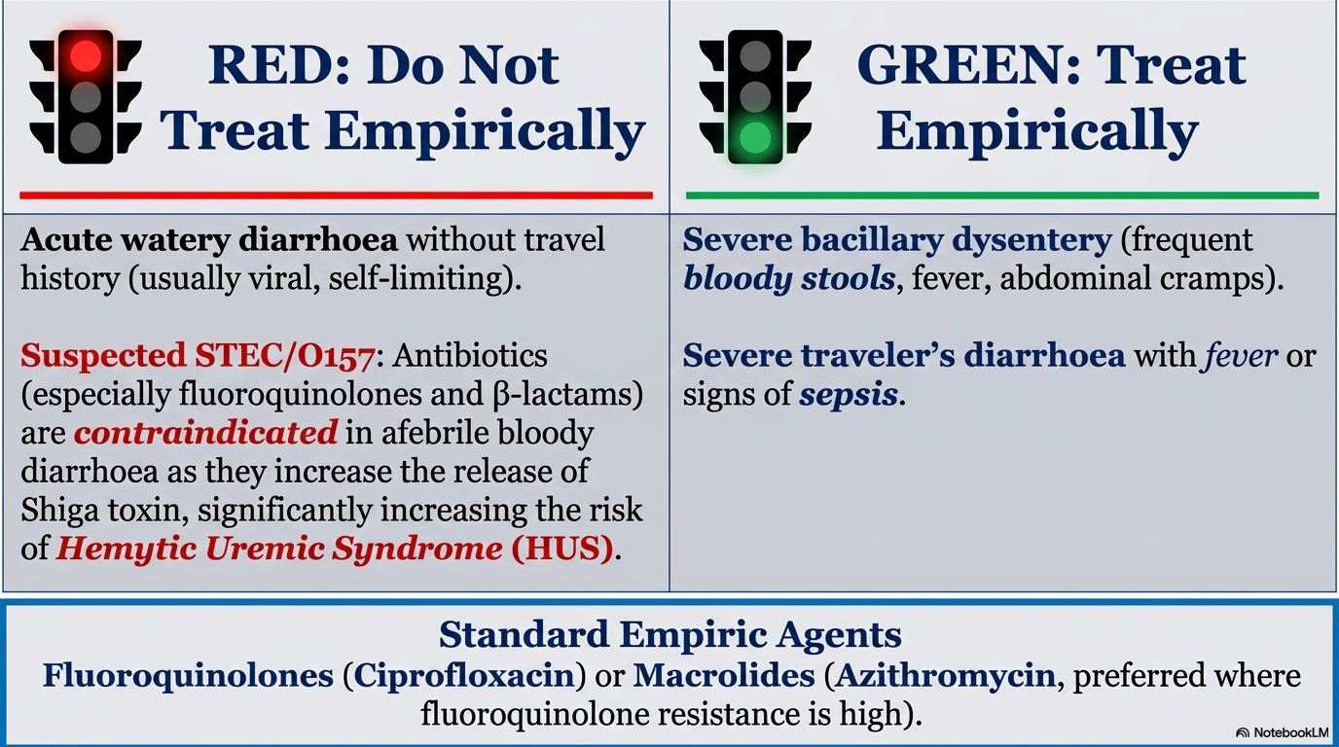

Slide 32
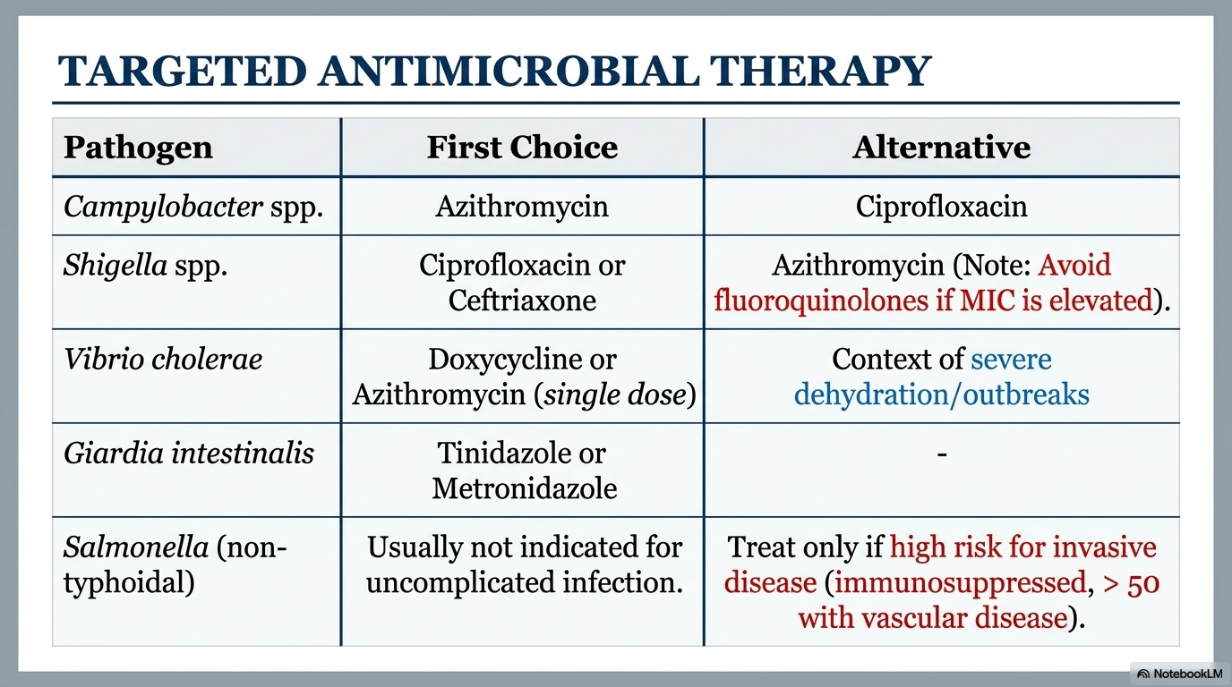

Slide 33
Role of Probiotics in Infectious diarrhea
Probiotics may improve infectious diarrhoea through:
Competition for nutrients and binding sites within the gut
Production of substances such as bacteriocins and organic acids, and neutralizing bacterial toxins
Stimulation of mucosal immune responses and reduction of intestinal inflammation and permeability
Guarner F, Khan AG, Garisch J, Eliakim R, Gangl A, Thompson A, et al. World Gastroenterology Organisation global guidelines: probiotics and prebiotics. Journal of Clinical Gastroenterology
Notes:
Probiotics are defined by FAO and WHO as "live microorganisms that, when administered in adequate amounts, confer a health benefit on the host
Restoring normal intestinal flora Competing with pathogenic organisms Producing antimicrobial substances Enhancing mucosal immunity Improving gut barrier function
Prebiotics are non-digestible food substances that promote the growth and activity of beneficial gut bacteria

Slide 34
Evidence on the use of Probiotics-1
Probiotics make little or no difference to the number of people who have diarrhoea lasting 48 hours or longer
Uncertain that probiotics reduce the duration of diarrhoea.
Collinson, S., et al. (2020). Probiotics for treating acute infectious diarrhoea. Cochrane Databaseof SystematicReviews,2020(12).
Notes:
Some studies has shown effect, but 2 large RCT did not show the effect
Previous Review had shown effect of Probiotics in minimizing duration, done in 2019 , limitation, few studies were used which skewed the results

Slide 35
Evidence on the use of Probiotics-2
Probiotics are:
Safe for short or long time administration
Shown to demonstrate a mixed effect of therapy in gastroenteritis in adults.
Effective in treating and reducing relapses of chronic inflammatory gastrointestinal conditions in most adults about 78%
Shown to be ineffective in about 20% of patients
Mitra, A. K., Asala, A. F., Malone, S., & Mridha, M. K. (2023). Effects of Probiotics in Adults with Gastroenteritis: A Systematic Review and Meta-Analysis of Clinical Trials. Diseases, 11(4), 138.
Notes:
Further studies are required for establishment of which etiology will benefit for probiotics

Slide 36
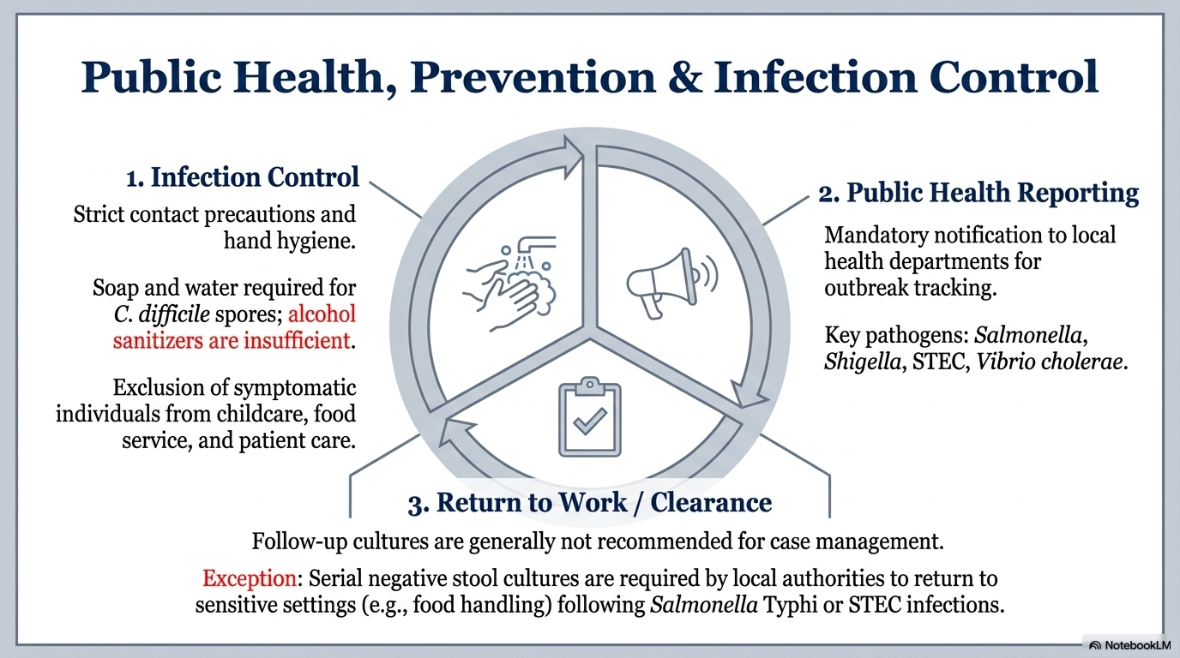
WHO operational guide on water, sanitation and hygiene and infection prevention and control measures for infectious diarrhoea in health-care settings, 2024

Slide 37
CLOSTRIDIUM DEFFICILE INFECTION (CDI)

Slide 38
General concept
Antibiotic-induced diarrhea
Antibiotic use
↓ normal flora
↓ breakdown of carbohydrates
↑ growth of resistant bacteria
Clostridium difficile
Klebsiella oxytoca
↑ luminal osmotic load
↑ luminal water
Diarrhea
Notes:
Antibiotic-associated diarrhea develops in up to 30% of hospitalized patients

Slide 39
CDI
The majority of C. difficile infections are induced by antimicrobial agents.
The risk is high when administration of agents that have a great impact on the normal gastrointestinal microflora
Traditionally considered a primary healthcare-associated infection, C difficile is also increasingly diagnosed within community settings
1.Barbut F, Petit JC. Epidemiology of Clostridium difficile-associated infections. Clin Microbiol Infect 2001; 7: 405 – 10
2. Mada PK, Alam M, StatPearls AM. Clostridioides difficile infection. 2024. [3-July-2024]. https://www.ncbi.nlm.nih.gov/books/NBK431054/

Slide 40
Epidemiology-1
Clostridioides (Clostridium) difficile infections (CDI) have become an emerging health threat
Recently, the prevalence of CDI among adults and children with diarrhea in Mwanza has been documented to be 6.4%
Use of antibiotics has been documented to be strongly associated with CDI in children

Slide 41
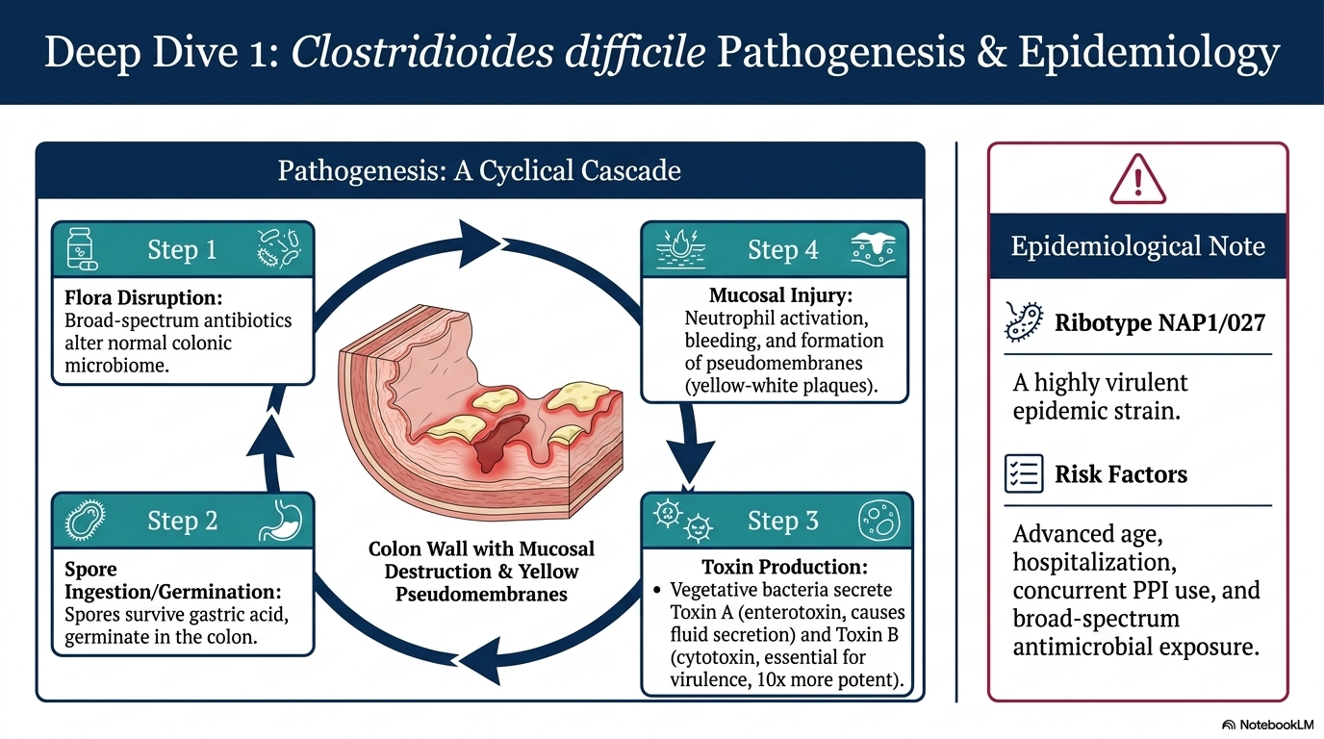

Slide 42
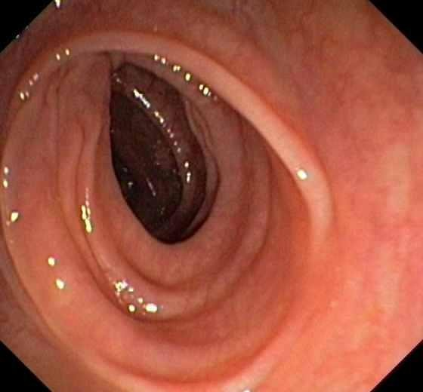
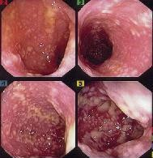
Normal
Pseudomembranous colitis

Slide 43
Diagnosis of C. difficile diarrhea
Stool culture: difficult and many false positive results
GDH Antigen testing
Cytotoxicity assay, sensitivity 94-100% and specificity 99%, expensive and requires 2-3 days
ELISA detection of toxins A and B, comparable specificity and sensitivity 70-90%
NAAT/PCR detection of the genes for both toxins is now preferred, sensitivity nearly 100% and specificity 97%, assays that detect both toxins preferred
Notes:
glutamate dehydrogenase enzyme from C. Difficile, GDH good for screening is very sensitive butcannot distinguish toxigeic and nonetoxigenic strains
Cell Cytotoxicity Neutralization Assay (CCNA) Detects: toxin effect on cultured cells (slow and technically difficulty)
ELISA- fast and specific to active disease, has lower sensitivity

Slide 44
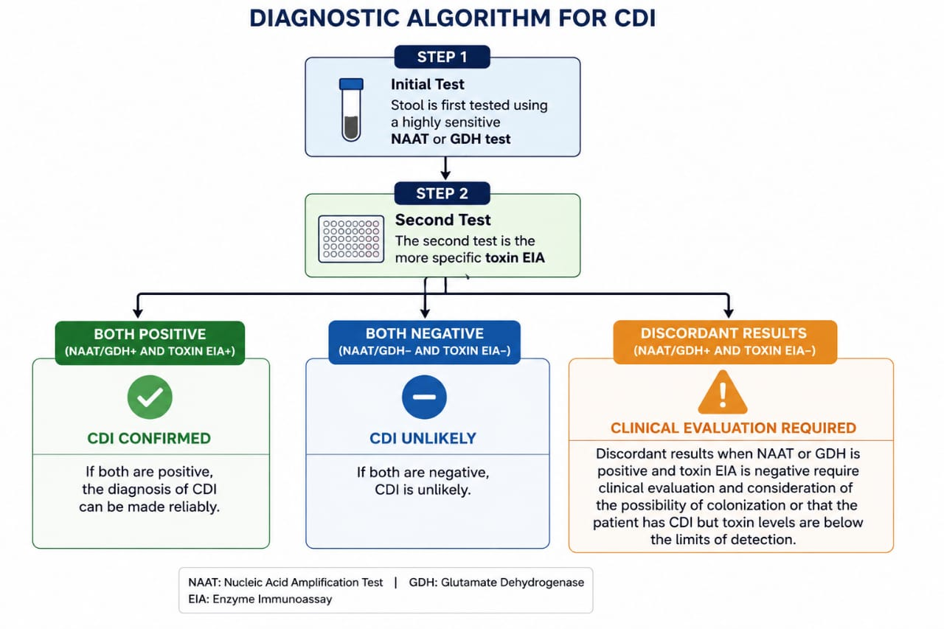
Notes:
Current IDSA/SHEA and ACG guidelines recommend because no single test is perfects. Required to combine the test with high sensitivity and high specificity

Slide 45
Treatment of C. difficile diarrhea-1
Whenever possible discontinue the offending antibiotic
Avoid antiperistaltic agents → ↑ risk of toxic megacolon
Fluids and electrolytes replaced
Metronidazole is no longer favoured as first line due to concerns around resistance,

Slide 46
Treatment of C. difficile diarrhea-2
Vancomycin and Fidaxomicin are now recommended as first line options.
Antibiotic therapy should be used in conjunction with good supportive measures
Early consideration of surgical management.
Faecal microbiota transplant can be utilized in recurrent CDI and may be useful in severe disease
Ubsdell, D., Maddox, N. L., & Sheridan, R. (2025). Management of severe and fulminant Clostridioides difficile infection in adults. Journal of Medical Microbiology, 74(4). https://doi.org/10.1099/jmm.0.001991
Notes:
Severe CDI is defined as patients with CDI and a leukocyte count 15 109 cells/L and/or creatinine 1.5 mg/dL.
Fulminant CDI presents as severe disease with shock, ileus, or megacolon
Fidaxomicn- macrocyclic antibiotics, minimally absorbed in gut, act locally, less impact on microbiota compared to vancomycin

Slide 47
Treatment of C. difficile diarrhea-3
In treatment of CDI when fidaxomicin or vancomycin are available, Fidaxomicin (200mg PO bid 10/7) is the preferred agent for treatment of initial CDI and the first recurrence of CDI
If fidaxomicin is unavailable, oral vancomycin should be given at 125 mg every 6 hours for 10 days.
If neither fidaxomicin nor vancomycin are available, metronidazole should be administered orally
1.Van Prehn, J., Reigadas, E., et al (2021). European Society of Clinical Microbiology and Infectious Diseases: 2021 update on the treatment guidance document for Clostridioides difficile infection in adults. Clinical Microbiology and Infection,
2.Mada PK, Alam M, StatPearls AM. Clostridioides difficile infection. 2024. [3-July-2024]. https://www.ncbi.nlm.nih.gov/books/NBK431054/

Slide 48
Treatment of C. difficile diarrhea-4
ESCMID 2021 recommends bezlotoxumab is considered as an adjuvant treatment for recurrent CDI alongside standard-of-care antibiotics when fidaxomicin is not available or feasible. .
IDSA 2021 recommends that for patients with a recurrent CDI episode within the last 6 months, bezlotoxumab is used as a co-intervention along with antibiotics rather than antibiotics alone
Johnson, S. er al. (2021). Clinical Practice Guideline by the Infectious Diseases Society of America (IDSA) and Society for Healthcare Epidemiology of America (SHEA): 2021 Focused Update Guidelines on Management of Clostridioides difficile Infection in Adults. Clinical Infectious Diseases, 73(5), e1029–e1044.

Slide 49
Prevention of C. difficile diarrhea-1
Use of Probiotics in Prevention of CDAD
PLACIDE Trial (2013)- no significant difference between Intervention group and Control (placebo) group in prevention of Antibiotic Associated Diarrhea.
Follow up observational of PLACIDE trial revealed no overall probiotic benefit but identified potential microbiota subgroups that might respond differently
These findings warrant further trial on personalized probiotic intervention
Notes:
The PLACIDE trial (“Probiotics to Lower Antibiotic‐associated & Clostridium-Induced Diarrhoea: Evaluation”) was a large, pragmatic randomized controlled trial testing whether a multistrain probiotic could prevent (AAD) and (CDAD) in older inpatients.
Randomized, double-blind, placebo-controlled, multicenter pragmatic trial
Population: 2,941 hospitalized patients aged ≥65 years starting systemic antibiotics

Slide 50
Prevention of C. difficile diarrhea-2
Cochrane Review: Probiotics for the Prevention of Clostridioides difficile–Associated Diarrhea (2025 update)
Probiotic use has:
Small risk reduction compared to placebo/no treatment (low–moderate certainty)
American Collage of Gastroenterology still recommends against
Notes:
Cochrane Database of Systematic Reviews, updated Sept 11, 2025 , involved 47 trials
Cochrane rates the certainty of evidence as low to moderate because of risk of bias, missing outcome data, and variability across studies

Slide 51
Prognosis and prevention of C. difficile diarrhea
Toxic megacolon and bowel perforation arise in 0.4-4 % of patients, but have a mortality rate of 30-50 %; surgery is frequently needed
Hospital based IPC should be practiced to prevent patient to patient spread of spores
Physical hand washing
  Prolonged broad-spectrum antibiotics avoided if possible
  Limit the use of clindamycin

Slide 52
Infectious diarrhea in immunocompromised hosts
Notes:
CHRONIC DIARRHEA AS AIDS DEFINING ILLNESS
It becomes AIDS-defining when:
It is chronic (>1 month), AND
Caused by specific opportunistic organisms such as:
Cryptosporidium
Cystoisospora belli

Slide 53
Bacterial Enteric Infection in HIV/AIDS
HIV-associated alterations in mucosal immunity or intestinal integrity may increase the risk of enteric bacterial infections.
Gram-negative bacterial enteric infections are at least 10 times higher among adults with HIV than in the general population
Rates are lower among people with HIV who are treated with antiretroviral therapy (ART)
The risk of bacterial diarrhea is high in individuals with clinical AIDS or CD4 counts <200 cells/mm3.
(Guidelines for the Prevention and Treatment of Opportunistic Infections in Adults and Adolescents, n.d.)

Slide 54
Cont…
In US the most frequent isolated bacteria by culture from adults with HIV are Shigella, Compylobacter, non-typhoidal salmonella spp
Clostridioides difficile–associated infection (CDI) is common in people with HIV
In CDI low CD4+ count (<50cells/mm cubic) is an independent risk factor

Slide 55
Burden of CDI in HIV/AIDS
Out of 141 participants with diarrhea, 9 of them was positive for C. defficile
All 9 patients who were found to carry C. difficile reported that they had used antibiotics previously.
8 of of them were HIV-positive individuals while only one HIV-negative individuals
All 9 were susceptible to metronidazole, moxifloxacin and clarithromycin, while three isolates were resistant to clarithromycin
Seugendo, M., Mshana, S.. (2015). Clostridium difficile infections among adults and children in Mwanza/Tanzania: Is it an underappreciated pathogen among immunocompromised patients in sub-Saharan Africa? New Microbes and New Infections, 8, 99–102. https://doi.org/10.1016/j.nmni.2015.09.016

Slide 56
Clinical presentation
Three major clinical syndromes of infection are associated with Gram-negative enteric bacteria among people with HIV:
Self-limited gastroenteritis
Severe and prolonged diarrheal disease, potentially associated with fever, bloody diarrhea, and weight loss
Bacteremia associated with extra-intestinal involvement, with or without concurrent or preceding gastrointestinal (GI) illness.
(Guidelines for the Prevention and Treatment of Opportunistic Infections in Adults and Adolescents, n.d.)

Slide 57
Diagnosis and Investigations
Focused history
Physical examinations
Stool culture and sensitivity
Blood culture
For CDI, NAAT and EIA are required
Endoscopy with biopsy should be reserved
Notes:
glutamate dehydrogenase enzyme from C. Difficile, GDH good for screening is very sensitive butcannot distinguish toxigeic and nonetoxigenic strains
Cell Cytotoxicity Neutralization Assay (CCNA) Detects: toxin effect on cultured cells (slow and technically difficulty)
ELISA- fast and specific to active disease, has lower sensitivity

Slide 58
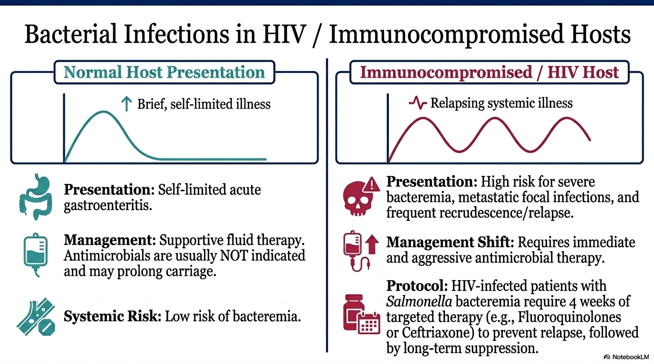
(Guidelines for the Prevention and Treatment of Opportunistic Infections in Adults and Adolescents, n.d.)
Notes:
TAKE HOME MESSAGE
-IMMUNOCOMPROMIZED- INVESTIGATIONS ARE IMPRTANT AND EMPERICAL ANTIIOTICS ARE IMPORTANT TOO
-TO PREVENT RISK OF RELAPSE- LONG DURATION OF THERAPY IS REQUIRED
-RISK OF CDI IS HIGH IN PT LOW CD4 COUNTS

Slide 59
Vaccine in Infectious diarrhea

Slide 60
Vaccine in Infectious diarrhea
Vaccines play a critical role as a primary prevention strategy in reducing the global morbidity and mortality associated with infectious diarrhea

Slide 61
Cholera Vaccine
Public Health Use
WHO recommends the use of oral cholera vaccines together with traditional control measures, including health promotion, provision of safe water and improving sanitation
Cholera endemic areas
During cholera outbreaks
Traveler’s to endemic areas

Slide 62
Cholera Vaccine
Only two serogroups, O1 and O139, cause cholera outbreaks.
V. cholerae O1 has caused all recent outbreaks.
Currently, three WHO pre-qualified oral cholera vaccines (OCV) are available:
Dukoral, Euvichol-Plus, and Euvichol-S
Due to shortage, 2022 WHO suspended 2-dose regime
1-dose strategy has proven effective in responding to outbreaks
CVD 103-HgR , ORAL LIVE ATTENUATED Single dose, Rapid protection, Mainly used for travelers, Licensed in some high-income countries
Cholera Annual Report 2023. Weekly Epidemiological Record, 9 September 2024, Vol 99 (36), (pp 481- 496).
Notes:
All require two doses to fully protect an adult. One dose of Euvichol-Plus® or Euvichol-S®(killed oral cholea vaccine) provides good short-term protection. Euvichol-S®, pre-qualified by WHO in 2024, is a simplified version of Euvichol-Plus® is available in global market. Due to shortage only single dose I given
Euvichol-Plus, and Euvichol-S are only available for mass vaccination campaign, supported by GAVI
Dukoral recombinant cholera toxin B subunit, made for travelers to endemic area, expensive
CVD 103-HgR , ORAL LIVE ATTENUATED Single dose, Rapid protection, Mainly used for travelers, Licensed in some high-income countries

Slide 63
Cholera Vaccine
As result of Global shortage, IVI conducted a phase 3 trial
It was comparing the lower-cost formulation between Euvichol-S and Shanchol.
It was successfully completed in Nepal in October 2022 where demonstrated the non-inferiority of Euvichol-S compared to Shanchol
For more information, please visit https://www.ivi.int..
Notes:
IVI-International Vaccine Institute

Slide 64
Typhoid (Salmonella Typhi) Vaccine
Recommended as an adjunct to hand hygiene and food safety, particularly for those at high risk of exposure.
Indications: It is primarily recommended for:
Travelers to endemic regions
Household contacts of documented chronic carriers
Laboratory personnel.

Slide 65
Typhoid Vaccine Types
  Oral (Ty21a): A live attenuated vaccine given as enteric capsules to immunocompetent individuals and children ≥ 6 years old, requiring a booster every five years.
  Parenteral (Vi-polysaccharide): An injectable vaccine for adults and children ≥ 2 years old, with a booster recommended every two years.
  Typhoid Conjugate Vaccine (TCV): Newer single-dose conjugate vaccines can be used in children as young as six months and provide longer-lasting protection.
Limitations: Current typhoid vaccines do not offer protection against Salmonella Paratyphi A, B, or C

Slide 66
Considerations for Immunocompromised Patients
Patients with HIV or other forms of immunosuppression require careful vaccine selection:
Contraindications: Live attenuated vaccines, such as the oral typhoid vaccine (Vivotif), are strictly contraindicated in people living with HIV due to safety concerns.
Recommendations: For travelers with HIV, the inactivated Vi capsular polysaccharide typhoid vaccine is the preferred alternative.
While some cholera vaccines like CVD 103-HgR may be considered for HIV patients with CD4 counts >200 cells/mm³, their safety and efficacy in this population are not yet fully established.
Notes:
CVD 103-HgR , ORAL LIVE ATTENUATED Single dose, Rapid protection, Mainly used for travelers, Licensed in some high-income countries

Slide 67
References
Southwick F. Infectious disease. A clinical short course. 3rd Edition. New York: McGraw-Hill, 2014. Chapter 8.
Longo DL, Fauci AS, Kasper DL, Hauser SL, Jameson JL, Loscalzo J, editors. Harrison's principles of internal medicine. 18th ed. New York: McGraw-Hill, 2012. Chapter 128.
Dickinson B, Surawicz CM. Infectious diarrhea: an overview. Curr Gastroenterol Rep 2014; 16: 399. doi: 10.1007/s11894-014-0399-8.
2017 Infectious Diseases Society of America Clinical Practice Guidelines for the Diagnosis and Management of Infectious Diarrhea
Updates online
WHO

Slide 68
References cont…
ACG Clinical Guideline: Diagnosis, Treatment, and
Prevention of Acute Diarrheal Infections in Adults. Am J Gastroenterol advance online publication, 12 April 2016; doi:10.1038/ajg.2016.126
Kansakar P, Baral P, Malla S et al. Antimicrobial susceptibilities of enteric
bacterial pathogens isolated in Kathmandu, Nepal, during 2002–2004.
J Infect Dev Ctries 2011;5:163–8
Rao SS. Constipation: Evaluation and treatment. Gastroenterol Clin North Am 2003; 32: 659-83

Slide 69
References cont
Guarner F, Khan AG, Garisch J, Eliakim R, Gangl A, Thompson A, et al. World Gastroenterology Organisation global guidelines: probiotics and prebiotics. Journal of Clinical Gastroenterology
Collinson, S., et al. (2020). Probiotics for treating acute infectious diarrhoea.Cochrane DatabaseofSystematicReviews,2020(12).
Ubsdell, D., Maddox, N. L., & Sheridan, R. (2025). Management of severe and fulminant Clostridioides difficile infection in adults. Journal of Medical Microbiology, 74(4). https://doi.org/10.1099/jmm.0.001991

Slide 70
References cont…
Van Prehn, J., Reigadas, E., Vogelzang, E. H., Bouza, E., Hristea, A., Guery, B., Krutova, M., Norén, T., Allerberger, F., Coia, J. E., Goorhuis, A., Van Rossen, T. M., Ooijevaar, R. E., Burns, K., Scharvik Olesen, B. R., Tschudin-Sutter, S., Wilcox, M. H., Vehreschild, M. J. G. T., Fitzpatrick, F., & Kuijper, E. J. (2021). European Society of Clinical Microbiology and Infectious Diseases: 2021 update on the treatment guidance document for Clostridioides difficile infection in adults. Clinical Microbiology and Infection, 27, S1–S21. https://doi.org/10.1016/j.cmi.2021.09.038

Slide 71
References cont…
Johnson, S., Lavergne, V., Skinner, A. M., Gonzales-Luna, A. J., Garey, K. W., Kelly, C. P., & Wilcox, M. H. (2021). Clinical Practice Guideline by the Infectious Diseases Society of America (IDSA) and Society for Healthcare Epidemiology of America (SHEA): 2021 Focused Update Guidelines on Management of Clostridioides difficile Infection in Adults. Clinical Infectious Diseases, 73(5), e1029–e1044. https://doi.org/10.1093/cid/ciab549

Slide 72
References cont…
Seugendo, M., Mshana, S. E., Hokororo, A., Okamo, B., Mirambo, M. M., Von Müller, L., Gunka, K., Zimmermann, O., & Groß, U. (2015). Clostridium difficile infections among adults and children in Mwanza/Tanzania: Is it an underappreciated pathogen among immunocompromised patients in sub-Saharan Africa? New Microbes and New Infections, 8, 99–102. https://doi.org/10.1016/j.nmni.2015.09.016

Slide 73
References cont…
Cholera Annual Report 2023. Weekly Epidemiological Record, 9 September 2024, Vol 99 (36), (pp 481- 496). https://cdn.who.int/media/docs/default-source/dco/wer_36_2024_cholera-annual-report-for-2023_bilingual-proof.pdf?sfvrsn=86fb1faf_1
Randel, A et al, Infectious Diarrhea: IDSA Updates Guidelines for Diagnosis and Management, 2018
2024 Updates by the Infectious Disease Society of America and American Society of Microbiology. Guide to Utilization of the Microbiology Laboratory for Diagnosis of Infectious Diseases

Slide 74
Referrences
Acree Davis, A. M. (2017). Acute Diarrheal Infections in Adults. JAMA, 318(10), 957. https://doi.org/10.1001/jama.2017.8485,

